Slide 1
Software Testing Fundamentals and Testing Levels

Slide 2
Introduction to Software Testing
Software testing evaluates correctness, quality, and reliability of software.
Testing executes programs to identify defects.
Helps ensure software meets requirements.
Improves reliability and performance.

Slide 3
Objectives of Software Testing
Detect defects in software
Verify software functionality
Validate requirements
Improve quality and reliability

Slide 4
Need for software testing
Increasing software complexity
Human coding errors
Requirement misunderstandings
Critical systems require reliability

Slide 5
Software Testing Process
Test planning
Test case design
Test execution
Defect reporting
Test evaluation

Slide 6
Software Testing Process
Test planning: It is the foundation of the entire testing effort. It defines what will be tested, how, by whom, and when.
Key activities:
Define the scope of testing (what's in and out of scope)
Identify resources (team, tools, environments)
Estimate timelines and effort
Choose a testing strategy (manual, automated, or both)
Identify risks and mitigation plans

Slide 7
Software Testing Process
Test planning: It is the foundation of the entire testing effort. It defines what will be tested, how, by whom, and when.
Example: An e-commerce app is launching a new checkout feature. The test plan specifies:
Scope: Cart, payment gateway, order confirmation (out of scope: product catalogue)
Tools: Selenium for automation, JIRA for tracking
Timeline: 2-week test cycle starting Sprint 5
Risk: Payment API is third-party — mitigation is to use sandbox mocks

Slide 8
Software Testing Process
Test case design: This phase translates requirements into structured, executable test scenarios. Good test cases are clear, repeatable, and traceable to requirements.
A test case typically includes:
Test Case ID
Description / objective
Preconditions
Input data
Steps to execute
Expected result

Slide 9
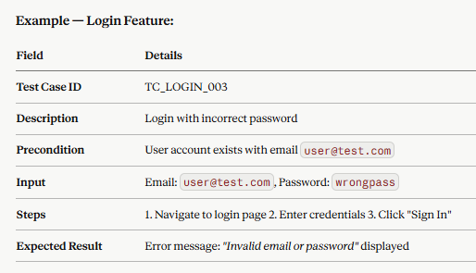
Software Testing Process
Test case design: This phase translates requirements into structured, executable test scenarios. Good test cases are clear, repeatable, and traceable to requirements.
A test case typically includes:
Test Case ID
Description / objective
Preconditions
Input data
Steps to execute
Expected result

Slide 10
Software Testing Process
Common techniques:
Equivalence Partitioning — group inputs into valid/invalid classes. Instead of testing every possible input (impossible), divide inputs into classes/groups where all values in a group are expected to behave the same way. If one value in the class works, they all should. If one fails, they all should.
Boundary Value Analysis — test edges (e.g., min/max values); Equivalence Partitioning tells you which classes to test. BVA goes further, it targets the edges of those classes, because that's where bugs most commonly hide. Developers often make off-by-one errors like using > instead of >=, so the boundary is where the logic is most fragile.
Decision Tables — for complex conditional logic. Some features don't just depend on a single input, they depend on multiple conditions combining to produce an outcome. Decision tables map every possible combination of conditions to its expected action.

Slide 11
Software Testing Process
Test execution: This is where test cases are actually run against the application, and results are recorded.
Key activities:
Set up the test environment (staging server, test DB, mock APIs)
Execute test cases manually or via automation
Log actual results vs. expected results
Mark each test as Pass, Fail, or Blocked
Example: A tester runs TC_LOGIN_003 on the staging environment:
Entered the wrong password → the app showed a generic success message instead of an error
Result: FAIL — a defect is raised
Regression testing is also performed here by re-running previously passing tests to ensure new changes haven't broken existing functionality.

Slide 12
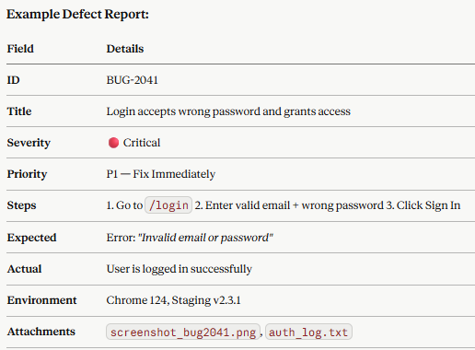
Software Testing Process
Defect reporting: When a test fails, the issue is formally documented as a defect (bug) so developers can reproduce and fix it.
A good defect report includes:
ID & Title — short, descriptive
Severity — Critical / High / Medium / Low
Priority — How urgently it needs fixing
Steps to Reproduce — exact, numbered steps
Actual vs. Expected Result
Environment — OS, browser, build version
Attachments — screenshots, logs, videos

Slide 13
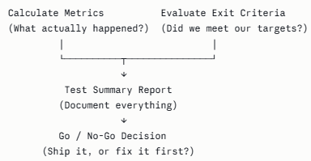
Software Testing Process
Test evaluation: The final phase assesses whether testing is complete and whether the software is ready for release.
Key activities:
Calculate test metrics (pass rate, defect density, coverage)
Evaluate against exit criteria set in the test plan
Produce a Test Summary Report
Make a go/no-go release recommendation

Slide 14
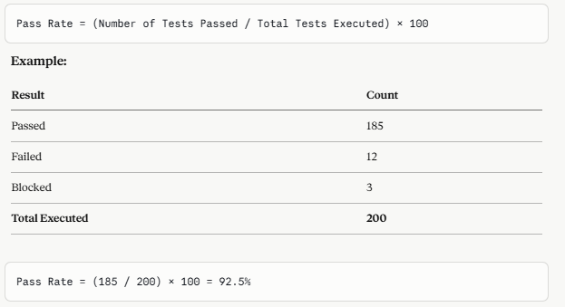
Software Testing Process

Slide 15
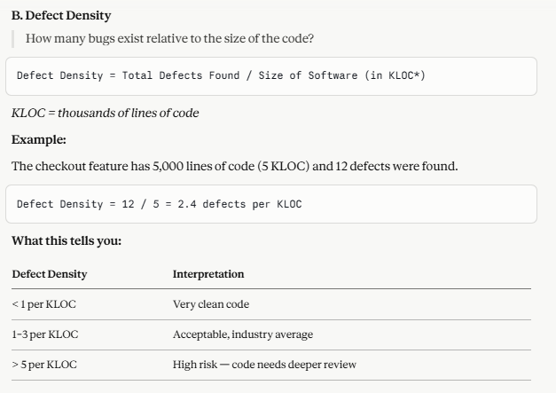
Software Testing Process

Slide 16
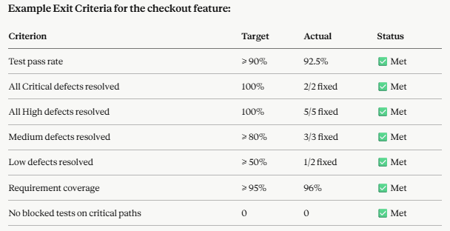
Software Testing Process

Slide 17
Testing Principles
1 | Testing shows presence of defects - Never say "there are no bugs" — say "no bugs were found during testing"
2 | Exhaustive testing is impossible - The goal is not to test everything, it's to test the right things.
3 | Early testing saves time and money - This is often called the "shift left" principle
4 | Defect clustering - Also known as the Pareto Principle (80/20 rule) applied to software
5 | Pesticide paradox - If you run the same tests repeatedly, they will eventually stop finding new bugs.
6 | Testing is context dependent - There is no one-size-fits-all approach to testing. How you test depends entirely on what you're testing.
7 | Absence of errors fallacy - A system can be technically flawless- no crashes, no bugs, all tests passing and still be a complete failure if it doesn't meet user needs or business goals.

Slide 18
Advantages of testing
Early bug detection
Simplifies debugging
Improves code quality
Supports continuous integration

Slide 19
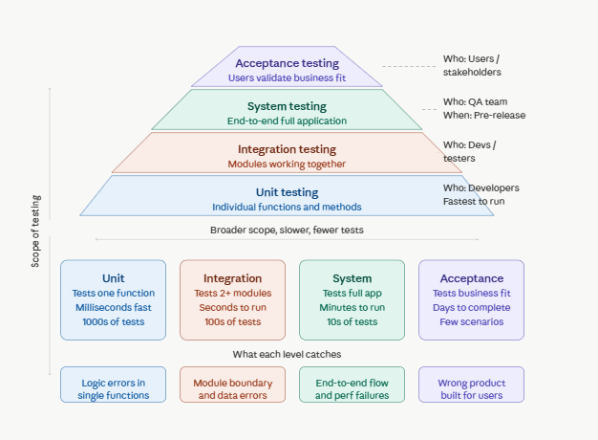
Levels of Software Testing

Slide 20
Unit Testing
A "unit" is the smallest testable piece of code in your application, typically a single function or method. The key word is isolated. You test that one piece of logic, completely cut off from everything else around it.
Written and run by developers, not testers
Runs extremely fast (milliseconds per test)
Uses mocks to replace dependencies (databases, APIs, other modules)
Catches bugs at the earliest possible stage
Example: testing a login validation function

Slide 21
Unit Testing
Advantages of unit testing
Early bug detection
Simplifies debugging
Improves code quality
Supports continuous integration

Slide 22
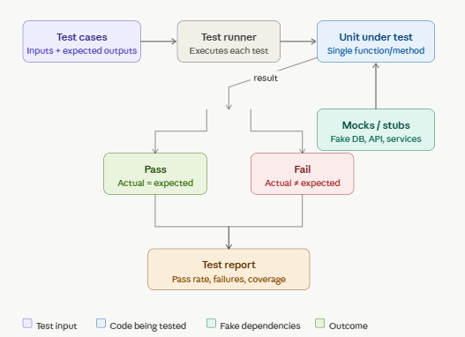
Unit Testing Diagram

Slide 23
Integration Testing
The moment two modules start communicating- passing data, calling each other, sharing a database- new categories of bugs emerge that unit tests are completely blind to. Integration testing is specifically designed to find those bugs.
Detects interface defects
Ensures modules work together
Occurs after unit testing

Slide 24

Integration Testing Strategies
Big Bang Integration: Integrate all modules at once, then test the whole thing together.
When something fails, it's very hard to tell which module caused it. Only used for very small systems.

Slide 25
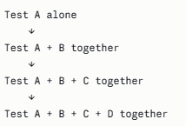
Integration Testing Strategies
Incremental Integration: Integrate and test one module at a time, building up progressively. This is the preferred approach.
When a failure appears, you know exactly which newly added module introduced it.

Slide 26
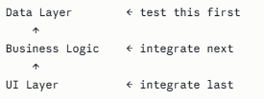
Integration Testing Strategies
Bottom-Up Integration: Start from the lowest-level modules and work upward. Higher modules not yet built are replaced with drivers (temporary callers that simulate the layer above).

Slide 27
System Testing
Test the system exactly the way a real user would use it, through the actual interface, against a real database, in an environment that mirrors production. Ensures system meets requirements
Performed by independent testing team
Includes functional and non-functional testing

Slide 28
System Testing Overview
Functional Test
Performance Test
Complete System
Security Test
Usability Test

Slide 29
Acceptance Testing
The development and QA team step back entirely and hand control to the actual stakeholders — clients, business representatives, and end users — who evaluate the software against their real-world needs.
The people testing are not technical. They are not reading code or following scripted test cases. They are using the software the way they naturally would in their daily work or life and judging whether it serves their actual needs.

Slide 30
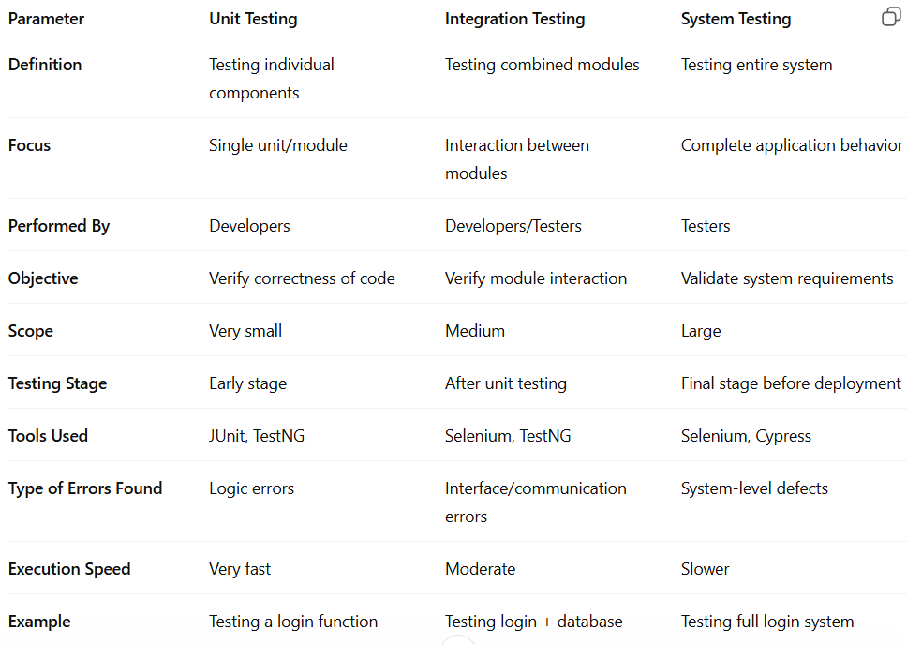
Comparison of various testing levels

Slide 31
Levels Of Testing : Unit testing validates individual methods. Integration testing verifies interaction between modules. System testing checks the entire application. Acceptance Testing checks if the software has delivered its purpose.

